Slide 1

College Knowledge for
Middle School and High School Freshmen Students
By Penelope Heller

Slide 2
A little about me.

Slide 3

Why Should I Attend College?
* Make more money
* Get to choose your career (dream job!!)
* Advance further in many careers
  Example: Don’t stop at being as construction worker, start a company.
* Meet new and different types of people
* Live in a different city
* Learn new things
* Research interesting ideas
* Learn from great teachers / experts
* Get a profession (e.g., lawyer, doctor)
Think about what you want to do in your future and what you think you
need to do to get there.
Notes:
Typical earnings for bachelor's degree holders are $36,000 or 84 percent higher than those whose highest degree is a high school diploma. College graduates on average make $1.2 million more over their lifetime.
Oftentimes it's not necessarily what you study, but the fact that you studied something at all. Aside from training you in an expert field, college trains you to think analytically, understand complex subjects and communicate your own critical ideas about them. It also instills crucial skills like organization, self-discipline and the ability to complete tasks from start to finish. In other words, college helps mold you into a more professional individual. College graduates are twice as likely to launch a small business.
.

Slide 4

Is College For Everyone?

Slide 5
People of all genders, races, ethnicities, religions, backgrounds and more
People of all socioeconomic backgrounds
Students who want to be professional athletes
Undocumented students
Students going into the military
Students with IEPs and disabilities
Students who speak a language other than English
Students who are the first in their families to go to college
Notes:
Most professional athletes went to college. Additionally, in many professional sports, you must first compete at the college level. To get into college, though, you must first qualify with grades and test scores.
Students who are undocumented or without papers can apply to many different types of colleges and universities. No federal law prevents U.S. colleges from admitting undocumented students. Mostly colleges set their own rules on admitting undocumented students, so you should research the policies of colleges you are interested in attending. There is financial air and scholarships available. A number of college have programs, student organizations or centers that support first-generation immigrant students.
There are many benefits to going to college before going into the military. The military can help you pay for college. You can also enter the military at a higher rank and get paid more with your college degree.
Learning disabilities: College is for everyone, even if they have a different ability. Many schools have a resource center to support students with IEPs and disabilities. Lynn University, Beacon College in Florida has an education program for Learning and also Life Skills support
Often times, knowing another language might even help students be more successful in college. You have three or four more years to become more proficient at English – make this a priority by reading, speaking to English speakers like teachers and store workers, paying attention in class and even watching TV in English or watching videos. There are also resources at colleges to help students improve their English language if they wish to do so.
There are many students who are the first person in their family to go to college. It is a brave and courageous step to take and it should be celebrated! There are many resources out there to help students who are the first in their family to get to college

Slide 6
Will College Be Boring?
No.

Slide 7
Differences Between Middle School/
High School and College
Middle School / High School | College
Average 30 hours/week in class | Spend 12 to 16 hours/ week in class
Full school day | Breaks in between classes; evening classes
Full school year | Two semesters
Time is usually structured by others | Students are independent.
Live at home | Live in a dorm.
Choose from a small list of classes. | Explore subjects which fit your interests.
Notes:
Students can have a wide range of experiences based on what they choose to participate in including clubs, sports and study abroad
HIGH SCHOOL: Average 30 hours each week in class, proceeding from one class to the next. School year is 36 weeks long; with short breaks in the winter and spring and a long one over the summer. Time is usually structured by others: administrators, teachers, coaches, and of course, parents.
COLLEGE: Spend 12 to 16 hours each week in class, usually with breaks in between. Students choose their classes and schedule. what days and time of day they want to take the class. Many classes offered in the evening. In most cases, the academic year is typically divided into two 15-17 week semesters. Students have a winter break and a spring break, and the academic year ends in May. Students are independent. College students manage their own time, including getting to class, doing homework, and studying. You’ll live in a dorm and have the chance to make friends from all over the world. Plus, in college courses you can better explore subjects which fit your interests.

Slide 8
Middle School/ High School vs. College Courses
Middle School/ High School Classes | College Courses
Biology | Fundamentals of Neuroscience
Algebra | The Mathematics of Chance
English | “All Too Well (Ten Week Version),”
Performing Arts | Producing for Television
Guitar | The Business of Music: Industry Essentials
Culinary Arts | Food fermentation: The Science of Cooking with Microbes
 | Study Abroad
Notes:
College is not only about academics, but the academics can be fun. The choices are much more tailored to interests.

Slide 9
I Want to Go to College. How Do I Get There ??!??

Slide 10
7th-8th
^{Grade}
Improve grades
Attendance
State test scores
Apply to good fit high schools
Plan high school curriculum
Build your vocabulary
Get Involved in clubs, sports, or leadership activities
Look ahead for AP and IB classes
Apply for scholarships
Take PSAT
9th
^{Grade}

Slide 11
10th
Grade
11th
Grade
Apply for Scholarships
Focus on getting and maintaining good grades
Get involved with activities
Take SATs or ACT
Focus on getting and maintaining good grades
Research and visit colleges
Gather teacher recommendation letters
Visit a college fair and attend in-school college presentations
Sign up on college websites and request information
Start thinking about essay topics
Apply for scholarships

Slide 12
12th
Grade
Apply to colleges
Apply for financial aid
Apply for scholarships

Slide 13
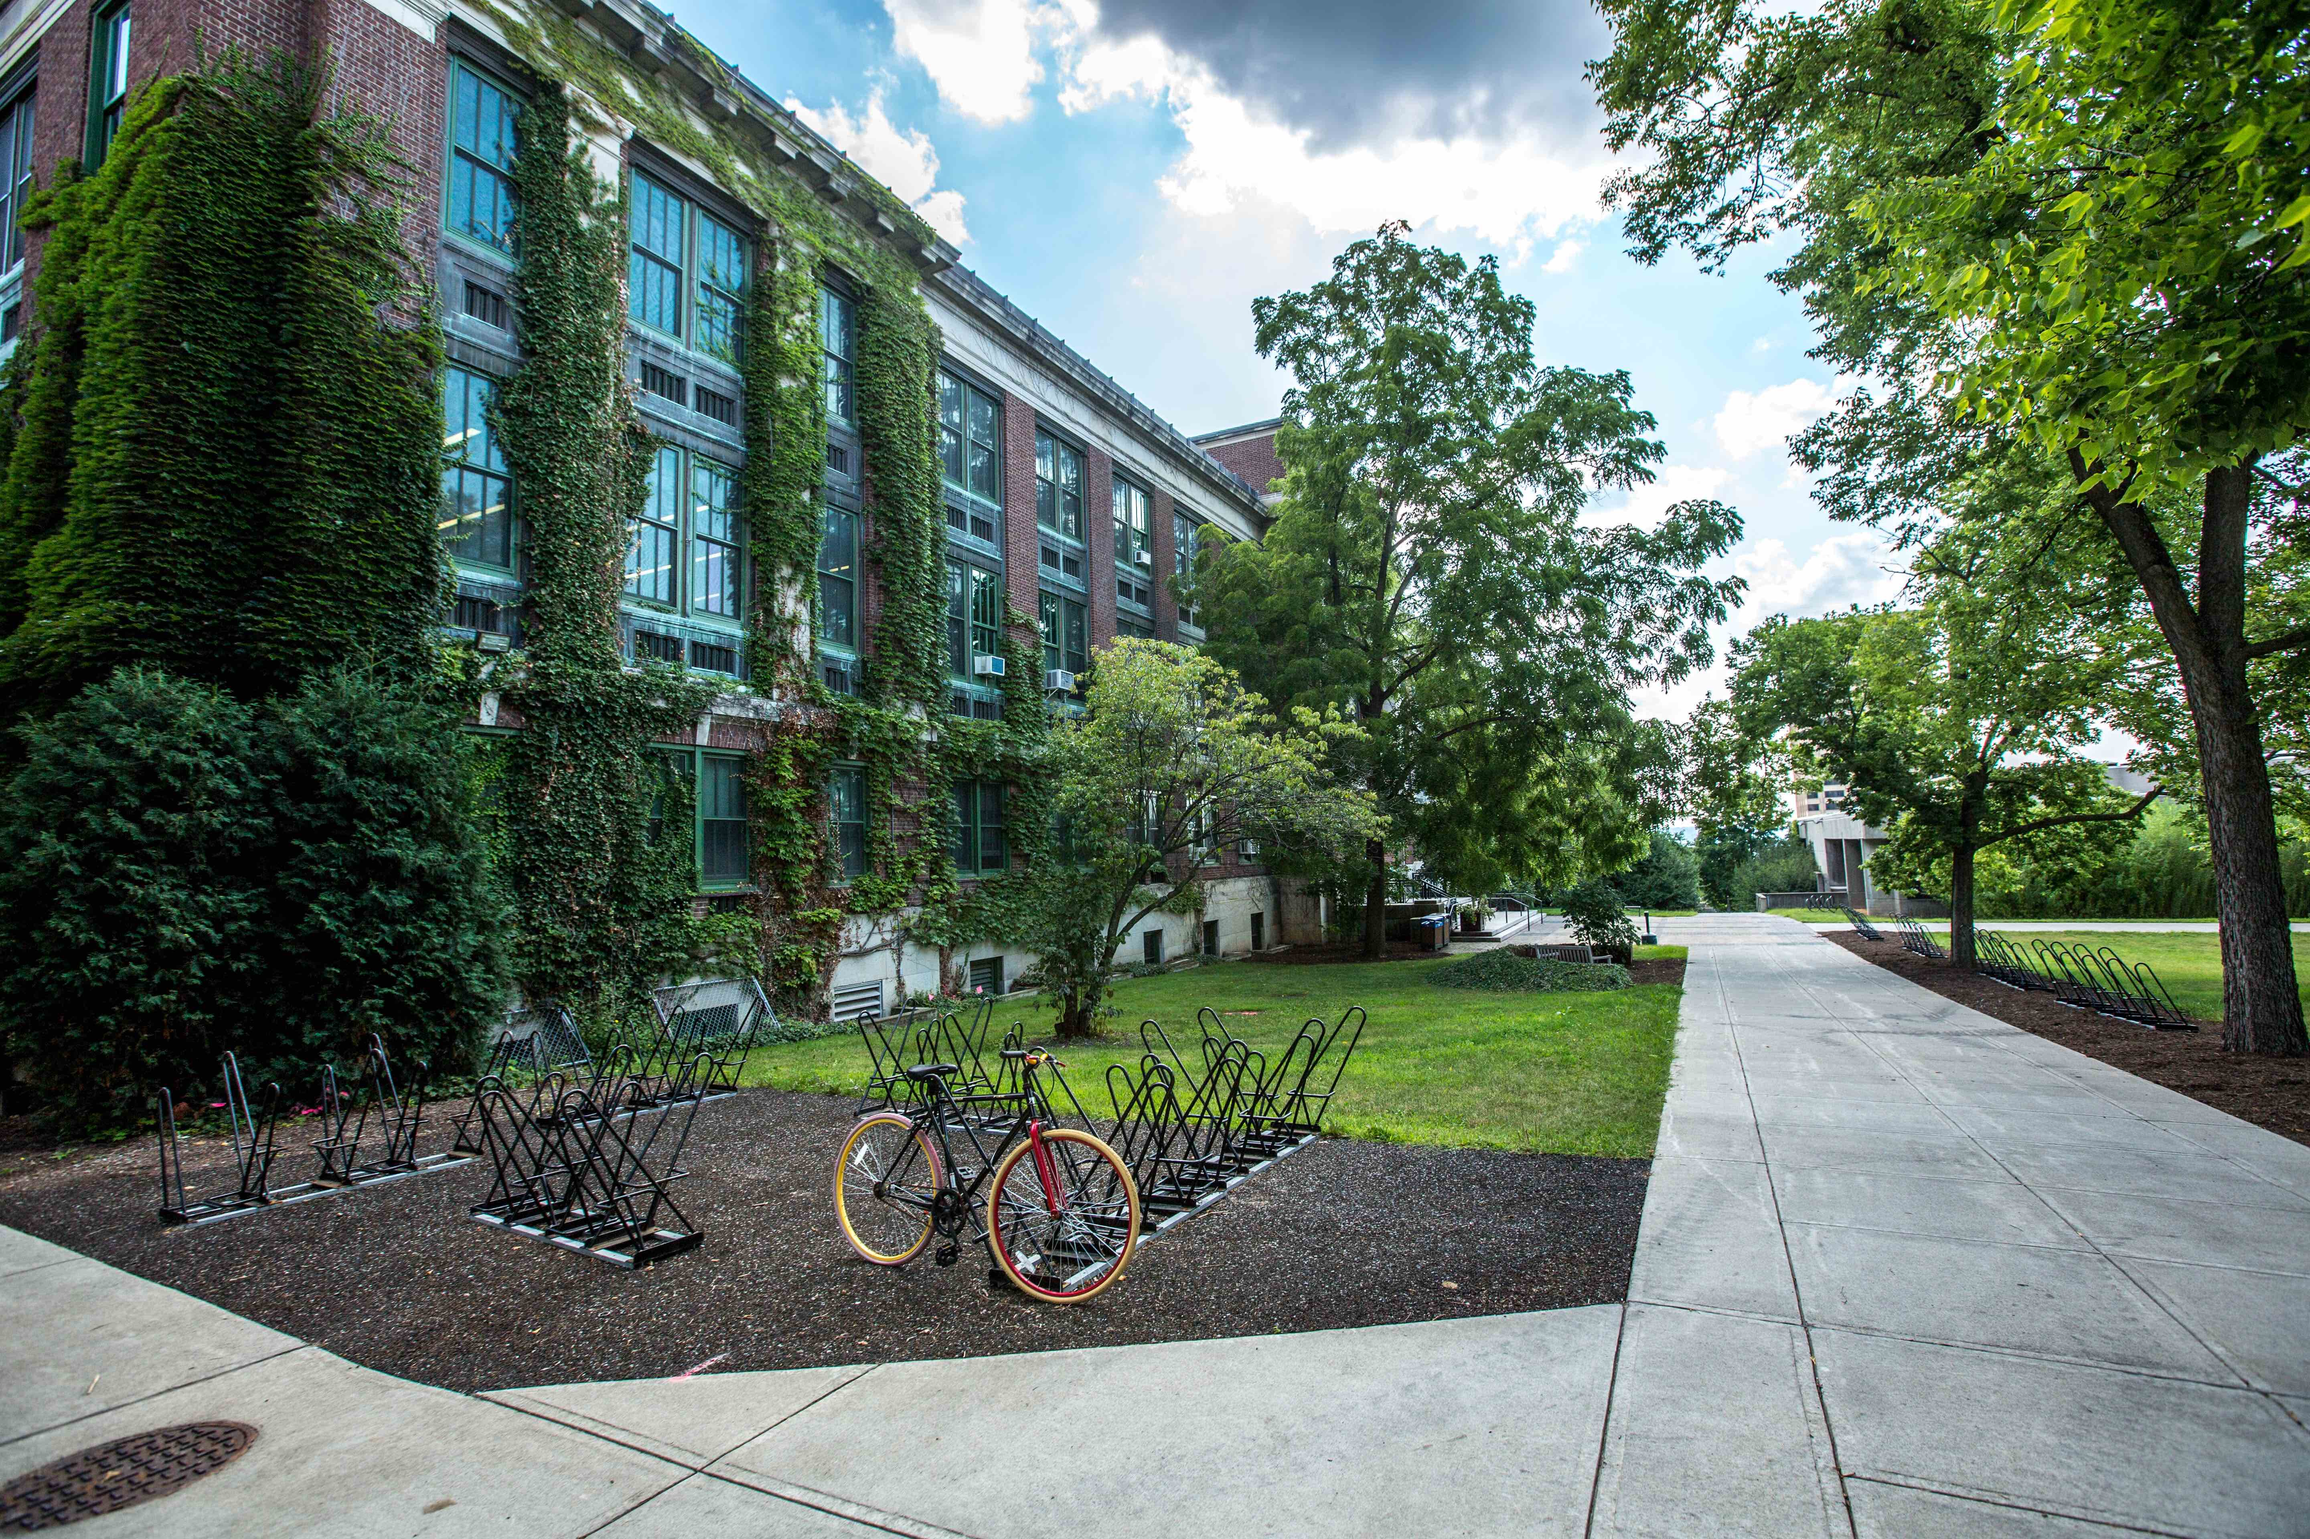
College Admissions Requirements May Include
* College Application
* College Tour
* Applying for Financial Aid (to get money to pay for college)
* Teacher Recommendation Letter
* Counselor Recommendation Letter
* Personal Statement/College Essay
* Application Fee (money you pay to apply to each college)
* Sending in your Transcripts (final report card)
* Getting involved in extracurricular and leadership activities
* SAT or ACT Test
Notes:
The SAT and ACT are no longer required at all colleges. A number of schools are test-optional meaning you can choose whether to submit scores. Test-blind schools mean that the schools won’t even look at the scores. Florida public schools require all applicants to submit test scores from the SAT and/or the ACT. University of Miami, a private school, is test optional.

Slide 14

Hurdles and High Walls
Some challenges will feel like a “high wall” that may stop you from moving forward to college.
Before telling yourself that you will never get to college, consider the solutions and reach out for support.

Slide 15


Slide 16
Common High Walls That Can Be Overcome
Cost
Falling behind in one of your classes
Unavailable college counselor.
Temptation of taking less challenging classes
Your family needs you to work or look after younger siblings
No one in your family has gone to college
Your college application requires an essay
Friends not planning to go to college.
Notes:
Everyone’s situation is different so I can’t offer specific advice for every person who is encountering one of these issues, but go to your counselor and ask for help. Your counselor wants to see each of you achieve your goals and dreams. And if your counselor seems too busy, be persistent.

Slide 17
Myth vs. Reality: College is only for people who are smart and get good grades
Better grades means more options of colleges to apply to.
Different colleges that require different types of grades and talents.
Many different paths can get to college.
Notes:
Better grades means more options of colleges a student can apply to and get accepted. Yes students with Bs and even Cs can get into college. Schools with higher acceptance rates mean they are easier to get into. College acceptance rates are a ratio—the number of total applicants to accepted students. For example, if 100 people apply to a college and 40 are accepted, the college has a 40% acceptance rate.

Slide 18

Paying for College: Myth vs. Reality
Myth: Private colleges are too expensive.
Reality: This is False.
Myth: Some colleges give full athletic scholarships to athletes
Reality:. This is true.
Myth: Only “A” students can go to college and get financial aid
Reality: this is false.
Myth: Applying for financial aid is impossible
Reality: This is false.
Notes:
Myth: Private colleges are too expensive.
Reality: False. Each school has different costs and some private colleges provide better financial help than public colleges.
Myth: Only “A” students can go to college and get financial aid
Reality: False. there are many colleges out there that accept different types of grades. On the other hand, the better grades you get in high school, the more options of colleges you have to apply to. While some financial aid and scholarships are based on your grades, others are based on how much your family makes a year or your background, talents, and extracurricular involvement in high school.
Myth: Some colleges give full athletic scholarships to athletes
Reality: True. It all depends on the college but you do need to maintain good grades in high school and in college to get this scholarship. Athletic scholarships are competitive and the recruiting process for some colleges starts as early as your freshmen year of high school.
Myth: Applying for financial aid is impossible
Reality: False. You just need about an hour and access to internet. There are also people who can help such as your guidance counselor, college counselor or community organization.

Slide 19

How To Pay for College
Grants: These are like free money!
Scholarships: Many are not just for sports or high grades.
Loans: Loans must be paid back.
Work study: Pay for college and get work experience.
Some employers pay for some college costs: Starbucks, Apple, Home Depot, AT&T, and more.
Notes:
Different universities have different costs and each offer various forms of support to help pay for college.
Grants: You can get grants from the federal government, your state, and your college.
Scholarship are not just for athletes or students with high grades. There are scholarships for being left-handed and for many things like being tall, being a first-generation college student, being involved in the arts, community service, and more. Also, there are essay contests. There are also various scholarships for undocumented students.
Loans: Students take out loans to help pay for school because your education is an investment. However, It is important to know what kind of loan you're taking out and how much you will be borrowing.
Work-study is a way for students to earn money to pay for school through part-time on- (and sometimes off-) campus jobs. Part-time and full-time students who demonstrate financial need are eligible.

Slide 20
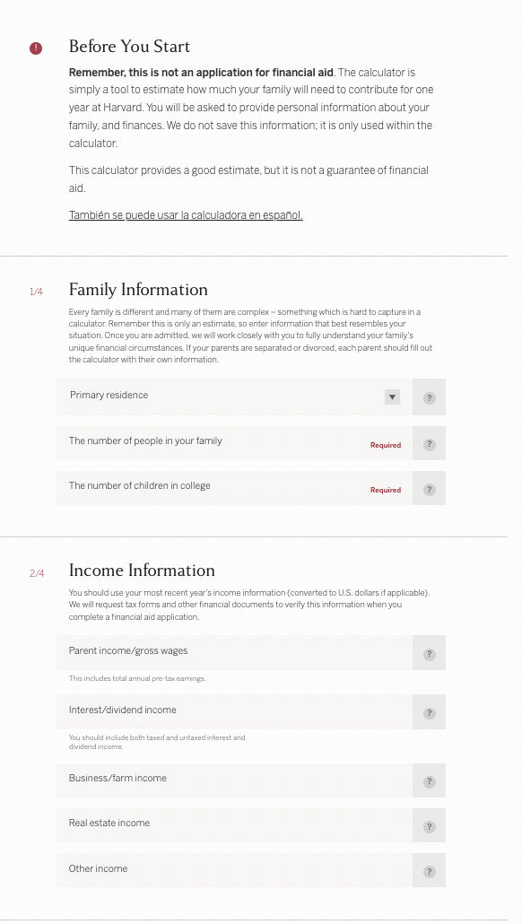
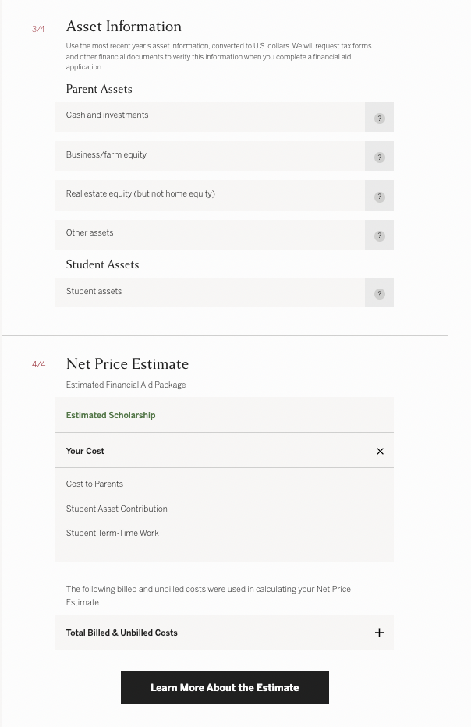
A Quick
Look at a
Net
Price
Calculator
Notes:
A school's sticker price is rarely the actual amount families will pay for college.
Check the net price calculator and the financial aid section of the college’s website, or search for the net price calculator on the college’s homepage. Net price is the amount that a student pays to attend an institution in a single academic year AFTER subtracting scholarships and grants the student receives. Net price calculators provide information about financial aid at each school early in the college search process so families can compare the cost of colleges,

Slide 21

Florida Bright Futures Scholarship
An amazing opportunity for Florida residents to earn a scholarship to college.
This scholarship program rewards Florida high school graduates for academic achievement and community service.
All Florida seniors who meet the requirements should complete the application. Even if you are NOT planning to attend a Florida college, you should apply.
Florida Academic Scholars (FAS) can receive an award to cover up to 100% of tuition and applicable fees when attending a public Florida college or university.
Florida Medallion Scholars (FMS) will receive an award to cover up to 75% of tuition and applicable fees.
Students attending a private school will receive a comparable amount .

Slide 22
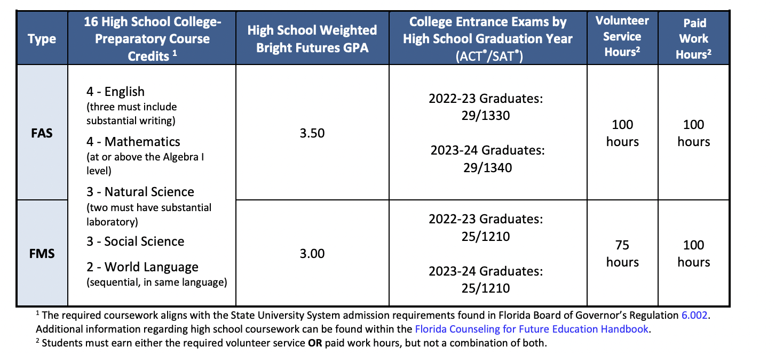
Florida Bright Futures Requirements
Notes:
FAS means Florida Academic Scholars and MMS means Florida Medallion Scholars. Florida Academic Scholars can receive an award to cover up to 100% of tuition and applicable fees when attending a public Florida college or university.
Florida Medallion Scholars will receive an award to cover up to 75% of tuition and applicable fees.
To qualify you have to
Complete the 16 college-preparatory courses required for admission to a state university.
Achieve the required weighted GPA per the chart below.
Achieve the required ACT® or SAT score.
Complete the required number of volunteer service or paid work hours per the chart on the next slide
While this is not easy to do, this can be done! This is why I am talking to you now when you are in middle school/ ninth grade. If you complete the IB or AICE curriculum and the service hours you can qualify for the Florida Medallion Scholars.

Slide 23
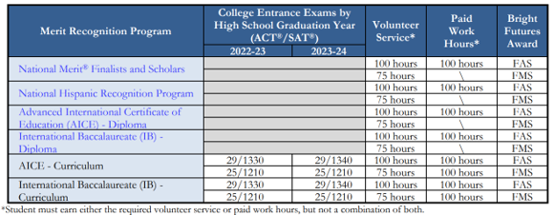
Florida Bright Futures Requirements

Slide 24
Where to Get Help
Counselors
Teachers
Staff
Family
Friends
Notes:
All want you to succeed and all feel confident in your ability to get to college.

Slide 25
I’m Nervous That I Won’t Make It to College!!!
This is normal.
Notes:
Feeling nervous about college is normal. There are many tools and resources out there to help you get to college. Your school hopes to help you with your first steps while you’re in 8th and 9th grade. Look to counselors, teachers, staff, family, and friends for support because we all want you to succeed and feel confident in your ability to get to college.

Slide 26


For more information and resources, visit CollegeforEveryStudent.com
Notes:
Thank you!

